Slide 1



Introduction to Foreign Direct Investment (FDI)
Foreign Direct Investment (FDI) plays a vital role in the economic growth and development of India. It involves investment in different sectors by foreign entities and has been a significant contributor to the country's economy.
by Shalini Pal

Slide 2
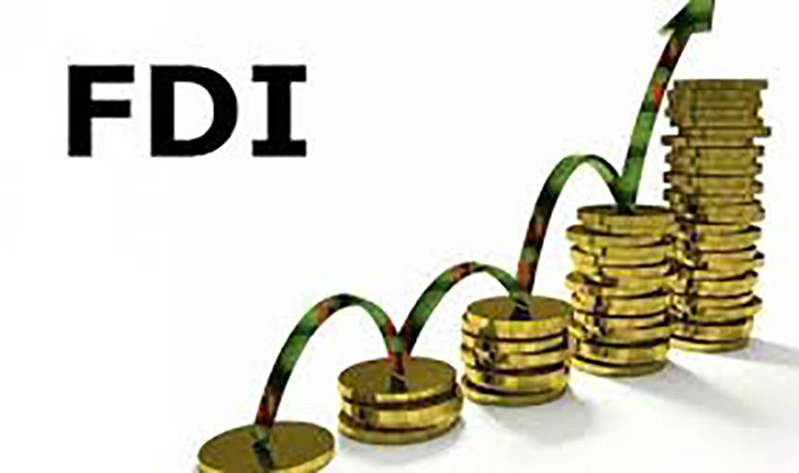



Error uploading image.
FDI trends in India from 2000-01 to 2016-17
1
2000-06
The first few years of the millennium showed a steady increase in FDI in India across various sectors.
2
2007-12
During this period, there was a significant surge in FDI, particularly in manufacturing and services industries.
3
2013-15
The latter half showed a slightly dropped inflows in the overall FDI.
4
2016-17
During this period, the highest amount of FDI is recorded, with an average percentage increase of 24%

Slide 3
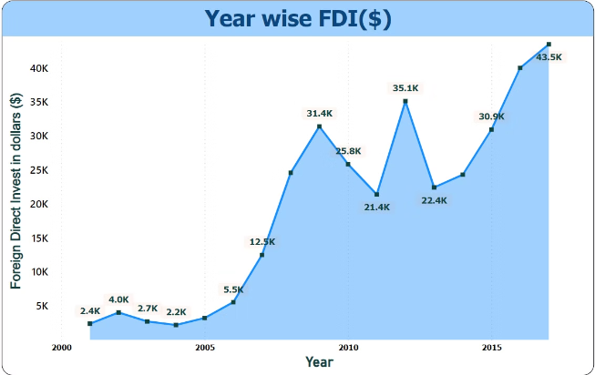
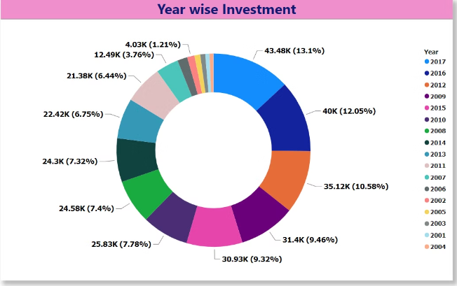
Year wise Foreign Direct Invest

Slide 4
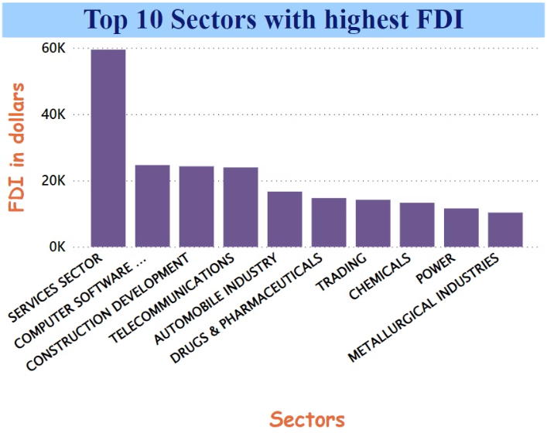
Sector-wise FDI inflows in India
Services
Computers
Construction development
Services sector, including telecommunications and financial services, received substantial FDI inflows.
Computers sector witnessed a surge in FDI, especially in Hardware and Software industries.
The Construction sector, after policy changes, saw a spike in FDI investment.

Slide 5



Error uploading image.
Impact of FDI on India's economy
1
Economic Growth
2
Technology Transfer
FDI has contributed significantly to the country's GDP growth and employment opportunities.
It has facilitated technology transfers, enhancing India's industrial and technological capabilities.
3
Infrastructure Development
Investments have spurred infrastructure development, benefiting various sectors nationwide.

Slide 6
Year wise FDI inflows
2001-06
2007-12
2013-17
Sustained Growth
Fluctuated
Major surge

Slide 7
Key metrics
Job Creation
Economic Diversity
Technological Advancement
Growth of Allied Sectors

Slide 8




Conclusion
Positive Growth Trajectory
Analysis of Foreign Direct Investment (FDI) trends from 2000 to 2017 reveals interesting insights into sectoral preferences and investment patterns. The data showcases a fluctuating trajectory of FDI inflows across various sectors, with notable shifts observed over the years.
Leading Investment Sector
Highest investments were made in the Service Sectors with a total of 59476.49$
Sustained Potential
After 2013, the FDI has continuously increased gradually overtime up to 2017 with an average percentage increase of 24%

